Slide 1
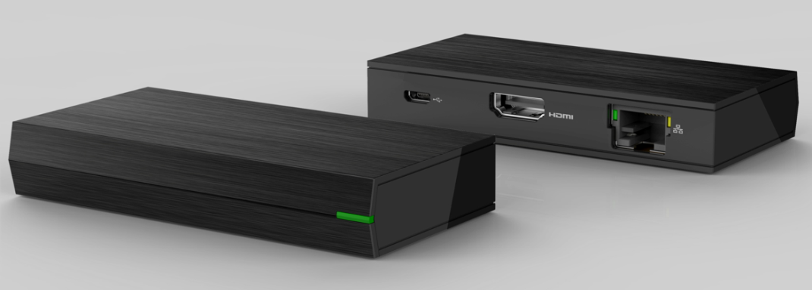
Mini Box Specification
OTT Box ID
Technical Specification
Chipset | Memory
AML S905X3 | 3 GB LPDDR4 8 GB eMMC flash (MLC type)
Interface | Features
HDMI 2.1 @ 4Kp60 output x1, HDCP 2.2 RJ-45x1; 10/100/1000 Mbps LED for power on/off indication Micro-USB for 5V @ 1A DC input | Main stream box for HEVC/4K video Google casting support Preload apps for TV services Over-The-Air image upgrade Android TV pre-certified Netflix NTS (optional)
Networking
10/100/1000 Base-T Ethernet Wi-Fi 802.11 ac/a/n 2x2 dual band Bluetooth 5.0 w/ BLE
Operating System
ATV (Android Q) Widevine Level 1/PlayReady DRM support
Please update the final size information
Dongle STB support only 5G wifi
So dual band should be changed or deleted
Highlight
Dimension | - 97.2mm x 45.5mm x 17.48mm
Wi-Fi 5GHz 2T2R Connection | - Support 802.11 ac/a/n
Operation environment | Temperature 0 ~ 40°C Humidity 10% ~ 90% relative humidity
Power adapter | 100~240VAC input, 5V/2A DC output
Safety/ Cert. | TBD
1
Notes:
1

Slide 2
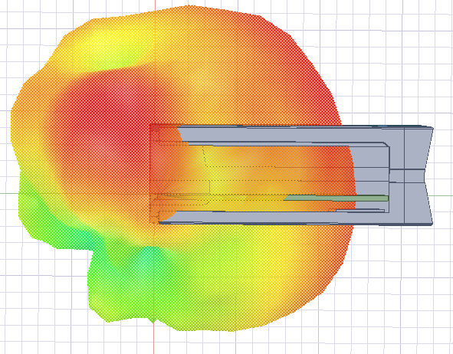
Wi-Fi Development Process (3/5)
Conducted test
Antenna test
Radiation test
Design prepare
OTA test
internal design target
  Frequency 5GHz: 5150 ~ 5350, 5470 ~ 5850MHz
  Directivity: ≥ +3dBi
  Efficiency: ≥ -50%
  VSWR: ≤ 2.0:1
  Return Loss : ≤ -10dB
Antenna passive test with mounting STB
  Antenna position: Simulation by using 3D antenna tool (HFSS)
  Antenna performance measurement in Anechoic chamber
The reason to reduce peak gain spec from +5dBi to 3dBi
Based on environment of dongle, expected to use chip antenna, but pattern design of chip antenna is fixed and the peak gain can’t be improved by adjusting antenna matching
Based on the design experience in previous project, the peak gain of chip antenna is about +3dBi
Antenna 3D plot
Please give me the test result of previous project.
If we request to change spec, We should prepare a detail evidence document.

Slide 3
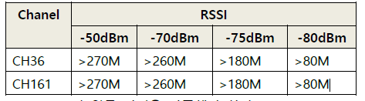
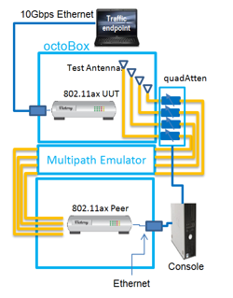
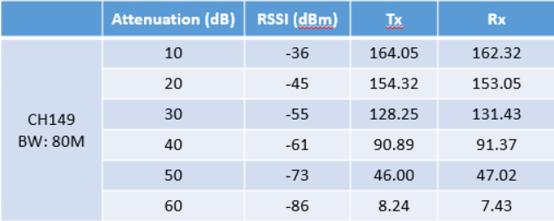
Wi-Fi Development Process (4/5)
Design prepare
Conducted test
Antenna test
Radiation test
OTA test
RvR(Wi-Fi Throughput Rate vs. Range in TCP) test
  Test Spec.:
  Test condition
  - In anechoic chamber or shield room
WIFI Throughput Tx/Rx test
- In anechoic chamber
Please suggest to RSSI test criteria.
Octobox environment setting
The following table is RvR test result using WIFI module
(chipset : RTL8822CS), when the attenuation is 10dB,
throughput less than 200Mpbs, so unable to meet over 270Mbps at -50dBm
Please refer to next page
* Above is reference data, need to use actual PCB to test

